Slide 1

An Analysis of r/Wallstreetbets’s effect on stock prices Capstone Project - Ryan
💎👐

Slide 2

Business Problem Statement
🚀🚀 🚀 🚀 🚀 🚀 🚀 🚀 🚀 🚀 🚀 🚀 🚀 🚀 🚀 🚀 🚀 🚀
Johnny 💎👐 is a MD of a foreign bank
Seen WSB influence on gme
Wants to use WSB’s activity to give the bank a trading edge
💎💎💎💎💎💎💎💎💎💎💎💎💎💎💎💎💎💎💎💎💎

Slide 3


Data Problem Statements
Is there a relationship between the sentiment or number of comments on WSB and stock prices?
Can we use stock data and WSB comments data to predict the next day’s price movement?

Slide 4

Data sources
Yahoo Finance: GME, TSLA, PLTR, NOK, BB, SP500, AMC
Kaggle: WSB comments (Feb-2018 to Feb 2021)

Slide 5
Data sources
Stock data columns:
Open, High, Low, Close, Volume
WSB comments columns:
created_utc, text

Slide 6
Data preparation
WSB data
Stock data
Data Cleaning Feature Engineering
Final Dataframes

Slide 7





Data Cleaning / Feature Engineering (WSB comments)
Remove NA values
Apply spacy’s sentiment and subjectivity models.
Convert unix timestamp (created_utc) to tz-aware datetime object
Get day_of_week and month label from created_utc
Available Columns
created_utc
text
sentiment
Subjectivity
month
day_of_week

Slide 8




Data Cleaning / Feature Engineering (Stock data)
Available Columns
Date
Open
High
Close
Low
Adj Close
Volume
pct_change
up_today
up_tomorrow
pct_volatility
day_of_week
month
Compared Open and Close values to get pct_change column
Compared Open and Close values to get bool column up_today and up_tomorrow
Remove all data prior to 16th Feb 2018
Compared High and Low values to get pct_volatility column
Converted Date column to tz-aware datetime object
Get day_of_week and month label from Date

Slide 9
Data preparation
WSB data
Stock data
Data Cleaning Feature Engineering
Final Dataframes
Group wsb data by date and obtain the following columns:
Mean subjectivity
Mean sentiment
Count of comments
Left join wsb data on stock data to obtain 7 different dataframes
Target variable is up_tomorrow

Slide 10
Final Dataframe Columns
Features:
Open : float64
High : float64
Low : float64
Close : float64
Volume : float64
up_today : bool
pct_change : float64
sentiment : float64
subjectivity : float64
comment_count : int64
day_of_week : category
month : category
Prediction column:
up_tomorrow : bool
WSB data
Stock data
Data Cleaning Feature Engineering
7 Dataframes for each stock

Slide 11
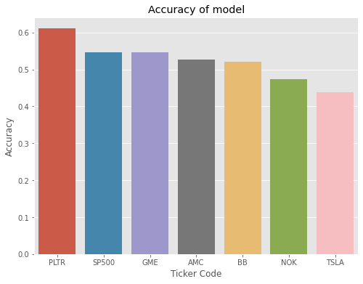
Results
Model used:
XGBoost Classifier:
80% : 20% train_test_split
Best accuracy performer is PLTR, over 60% accuracy
Model predicted the right movement 60% of the time

Slide 12
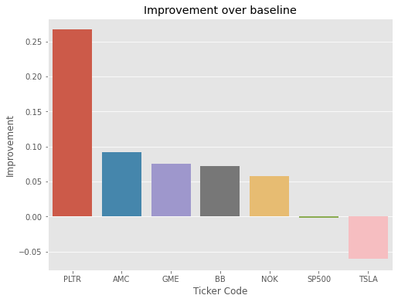
Results
Best improved model over baseline is PLTR
Baseline: predict stock is up every day

Slide 13
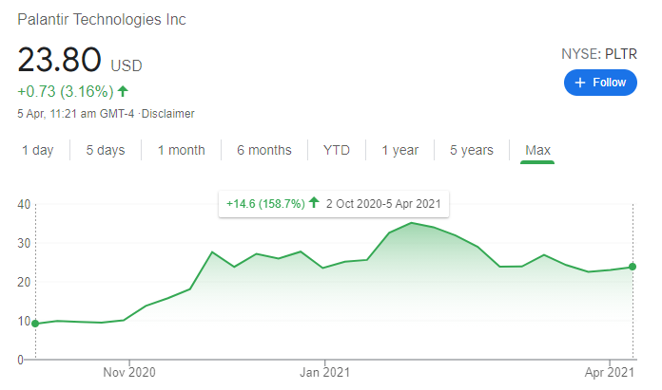
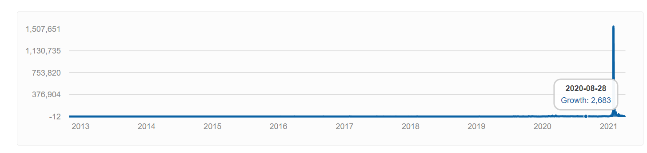
Analysis of results
PLTR IPO’d recently and stock data is only from 2nd Oct 2020 onwards
For all other stocks, the analysis runs from Feb-2018 to Feb-2021
Aug 2020 was the start of WSB’s huge membership growth
WSB’s influence initially is low due to low membership count

Slide 14
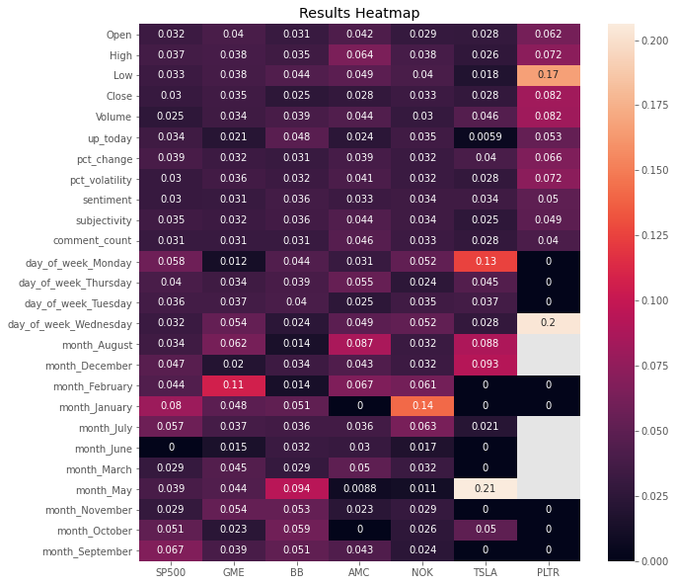
Feature Importances
PLTR – affected by low, and whether or not it is wednesday
TSLA – affected by whether or not it is monday and may
Most affected by WSB sentiment & subjectivity– PLTR
Most affected by WSB comment_count – AMC
Most affected by the month of January – GME
Most affected by the month of February

Slide 15


Future work
Train a BERT Model on labelled data for sentiment analysis
(Bidirectional Encoder Representations from Transformers)
Narrow the timeframe down to Aug-2020 onwards as this is the period of WSB’s explosive growth
Downsides: lack of data

Slide 16
Conclusion
The results of PLTR show that WSB is starting to have influence on the stock market
The cult-like behavior in WSB is contagious
WSB encourages people to hold stocks through memes – something never done before
There is also the desire to get back at hedge funds for the 08 crisis
The investing landscape has changed significantly since the Warren Buffet days
People were expecting a crash but no crash came
S&P broke 4000 during the middle of a pandemic
The economy and the stock market has decoupled

